Slide 1
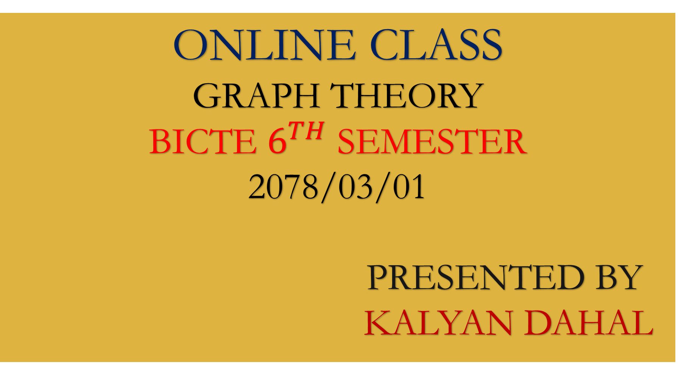
ONLINE CLASS
GRAPH THEORY
BICTE $6^{TH}$ SEMESTER
2078/03/01
PRESENTED BY KALYAN DAHAL

Slide 2
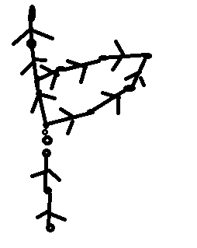
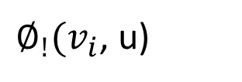

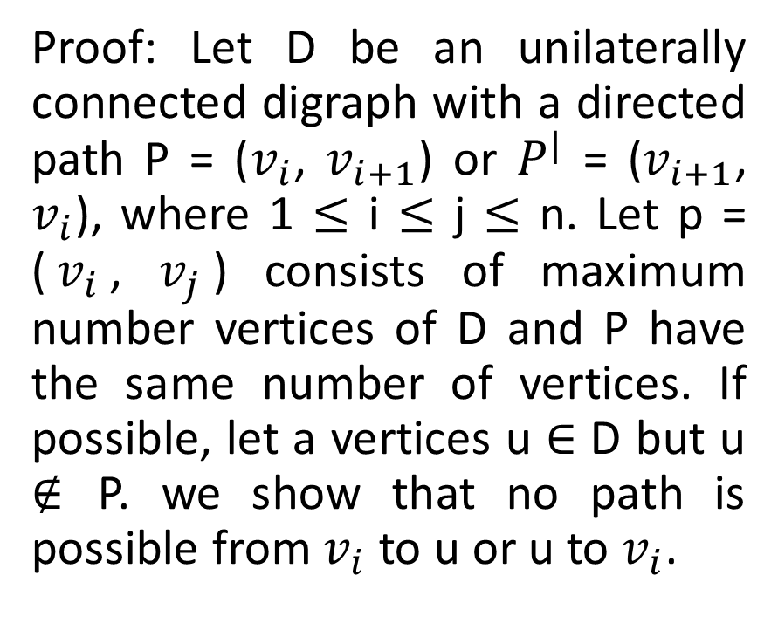



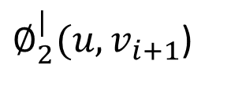
A digraph D is unilaterally connected digraph iff there is a directed spanning path in D.
Proof: Let D be an unilaterally connected digraph with a directed path P = ($v_{i}$, $v_{i+1}$) or $P^{|}$ = ($v_{i+1}$, $v_{i}$), where 1 $≤$ i $≤$ j $≤$ n. Let p = ($v_{i}$, $v_{j}$) consists of maximum number vertices of D and P have the same number of vertices. If possible, let a vertices u $∈$ D but u $∉$ P. we show that no path is possible from $v_{i}$ to u or u to $v_{i}$.
$$v_{n}$$
$∅_{2}^{|}(u,v_{i+1}$)
$$v_{i+1}$$
$$v_{i}$$
$∅_{!}(v_{i}$, u)
$$v_{1}$$

Slide 3
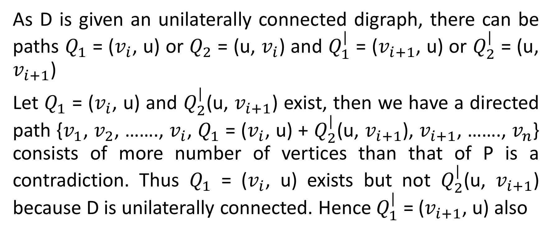
Continued….
As D is given an unilaterally connected digraph, there can be paths $Q_{1}$ = ($v_{i}$, u) or $Q_{2}$ = (u, $v_{i}$) and $Q_{1}^{|}$ = ($v_{i+1}$, u) or $Q_{2}^{|}$ = (u, $v_{i+1}$)
Let $Q_{1}$ = ($v_{i}$, u) and $Q_{2}^{|}$(u, $v_{i+1}$) exist, then we have a directed path {$v_{1}$, $v_{2}$, ……., $v_{i}$, $Q_{1}$ = ($v_{i}$, u) + $Q_{2}^{|}$(u, $v_{i+1}$), $v_{i+1}$, ……., $v_{n}$} consists of more number of vertices than that of P is a contradiction. Thus $Q_{1}$ = ($v_{i}$, u) exists but not $Q_{2}^{|}$(u, $v_{i+1}$) because D is unilaterally connected. Hence $Q_{1}^{|}$ = ($v_{i+1}$, u) also

Slide 4
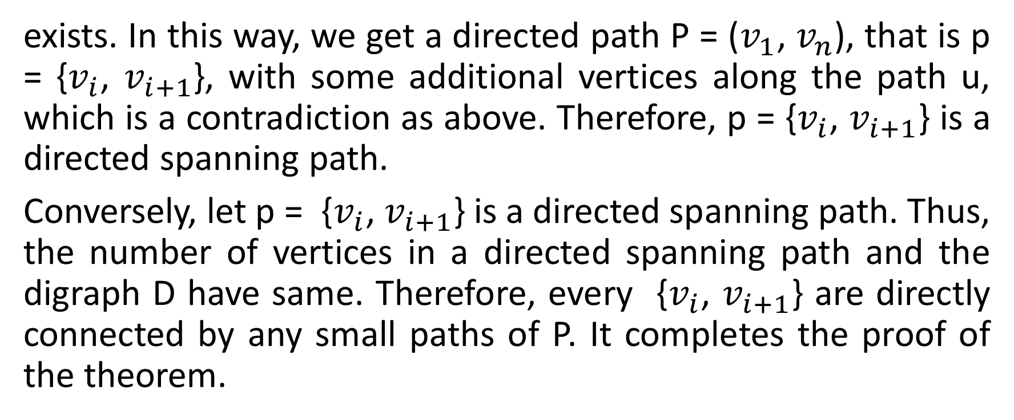
Continued….
exists. In this way, we get a directed path P = ($v_{1}$, $v_{n}$), that is p = {$v_{i}$, $v_{i+1}$}, with some additional vertices along the path u, which is a contradiction as above. Therefore, p = {$v_{i}$, $v_{i+1}$} is a directed spanning path.
Conversely, let p = {$v_{i}$, $v_{i+1}$} is a directed spanning path. Thus, the number of vertices in a directed spanning path and the digraph D have same. Therefore, every {$v_{i}$, $v_{i+1}$} are directly connected by any small paths of P. It completes the proof of the theorem.

Slide 5
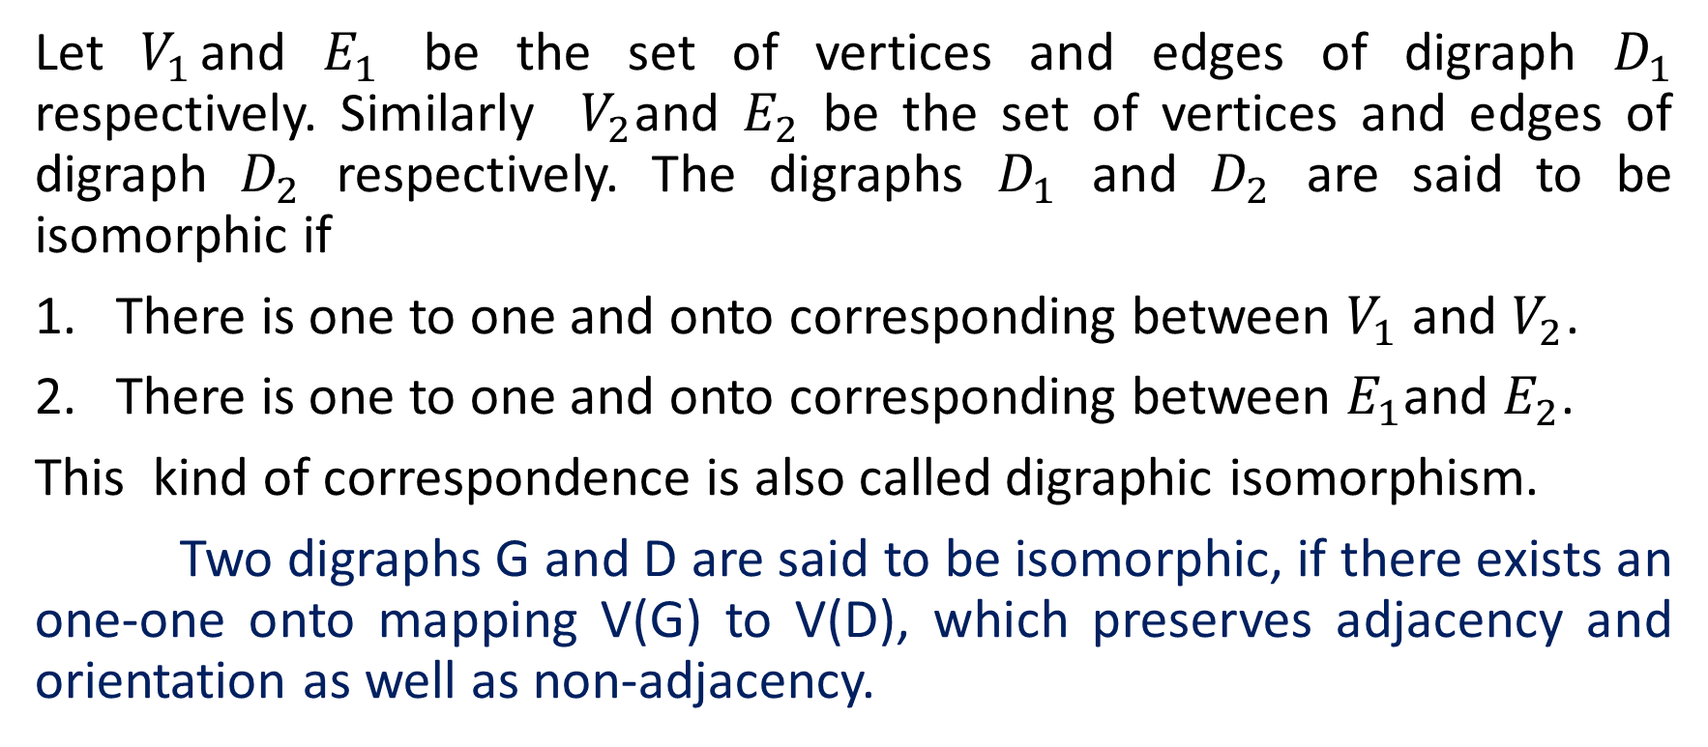
Isomorphic digraphs
Let $V_{1}$and $E_{1}$ be the set of vertices and edges of digraph $D_{1}$ respectively. Similarly $V_{2}$and $E_{2}$ be the set of vertices and edges of digraph $D_{2}$ respectively. The digraphs $D_{1}$ and $D_{2}$ are said to be isomorphic if
There is one to one and onto corresponding between $V_{1}$ and $V_{2}$.
There is one to one and onto corresponding between $E_{1}$and $E_{2}$.
This kind of correspondence is also called digraphic isomorphism.
Two digraphs G and D are said to be isomorphic, if there exists an one-one onto mapping V(G) to V(D), which preserves adjacency and orientation as well as non-adjacency.

Slide 6
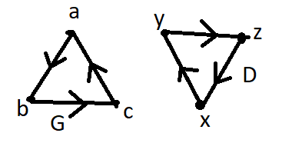
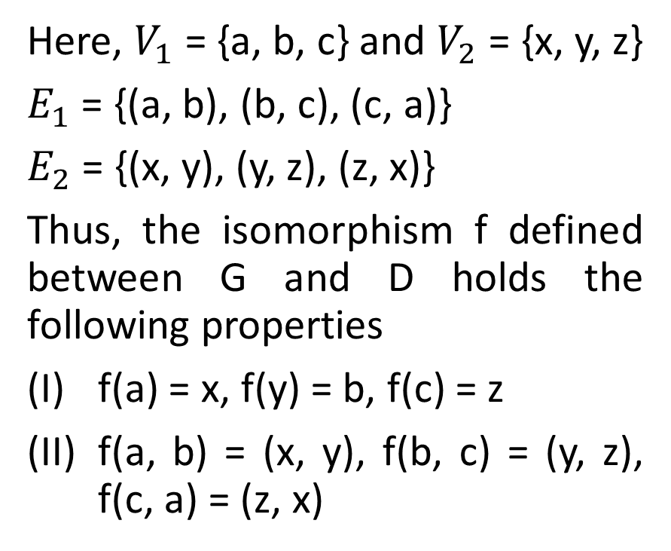
Isomorphic digraphs
Here, $V_{1}$ = {a, b, c} and $V_{2}$ = {x, y, z}
$E_{1}$ = {(a, b), (b, c), (c, a)}
$E_{2}$ = {(x, y), (y, z), (z, x)}
Thus, the isomorphism f defined between G and D holds the following properties
f(a) = x, f(y) = b, f(c) = z
f(a, b) = (x, y), f(b, c) = (y, z), f(c, a) = (z, x)

Slide 7
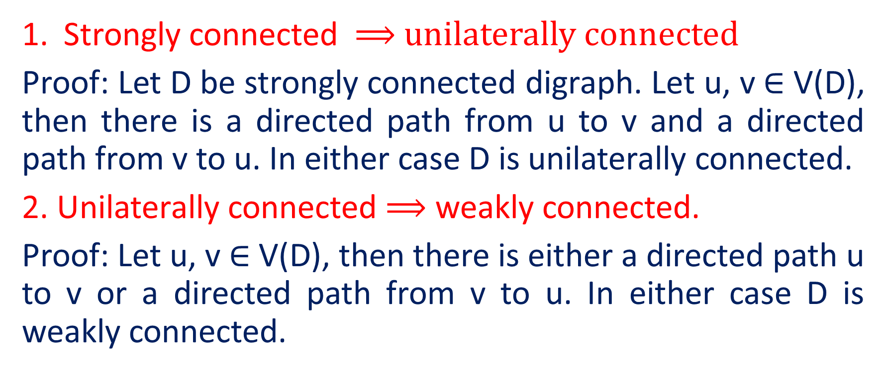
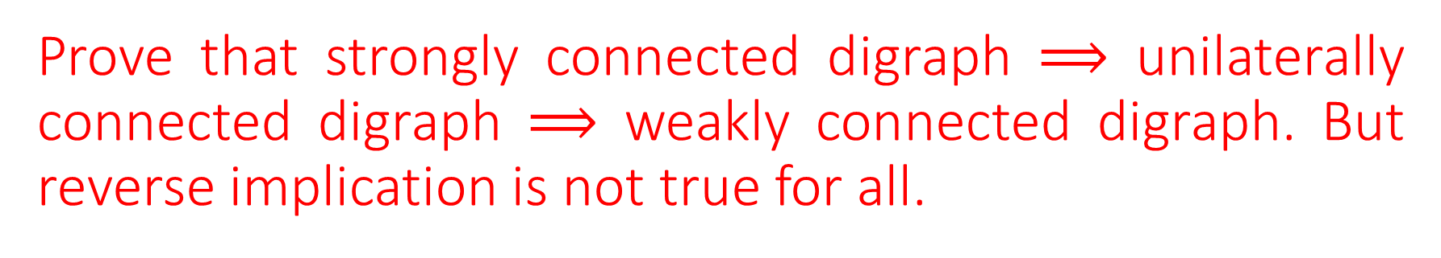
Prove that strongly connected digraph $⟹$ unilaterally connected digraph $⟹$ weakly connected digraph. But reverse implication is not true for all.
Strongly connected ⟹ unilaterally connected
Proof: Let D be strongly connected digraph. Let u, v $∈$ V(D), then there is a directed path from u to v and a directed path from v to u. In either case D is unilaterally connected.
2. Unilaterally connected $⟹$ weakly connected.
Proof: Let u, v $∈$ V(D), then there is either a directed path u to v or a directed path from v to u. In either case D is weakly connected.

Slide 8
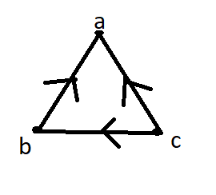

Continued….
3. Weakly connected $⇏$ unilaterally connected
The digraph D is weakly connected but not unilaterally connected, since there is no directed path from a to c.

Slide 9
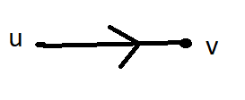

Continued….
4. Unilaterally connected $⇏$strongly connected.
We give a counter example which is unilaterally connected but not strongly. The graph given below is unilaterally connected which is not strongly connected.

Slide 10
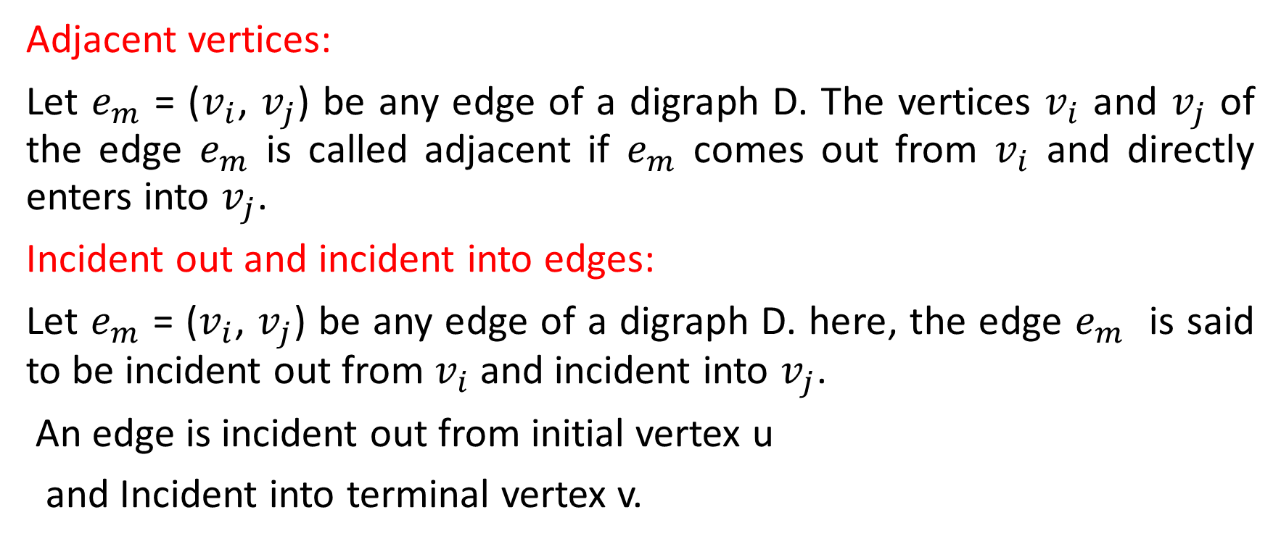
Traversability of digraphs
Adjacent vertices:
Let $e_{m}$ = ($v_{i}$, $v_{j}$) be any edge of a digraph D. The vertices $v_{i}$ and $v_{j}$ of the edge $e_{m}$ is called adjacent if $e_{m}$ comes out from $v_{i}$ and directly enters into $v_{j}$.
Incident out and incident into edges:
Let $e_{m}$ = ($v_{i}$, $v_{j}$) be any edge of a digraph D. here, the edge $e_{m}$ is said to be incident out from $v_{i}$ and incident into $v_{j}$.
An edge is incident out from initial vertex u
and Incident into terminal vertex v.

Slide 11
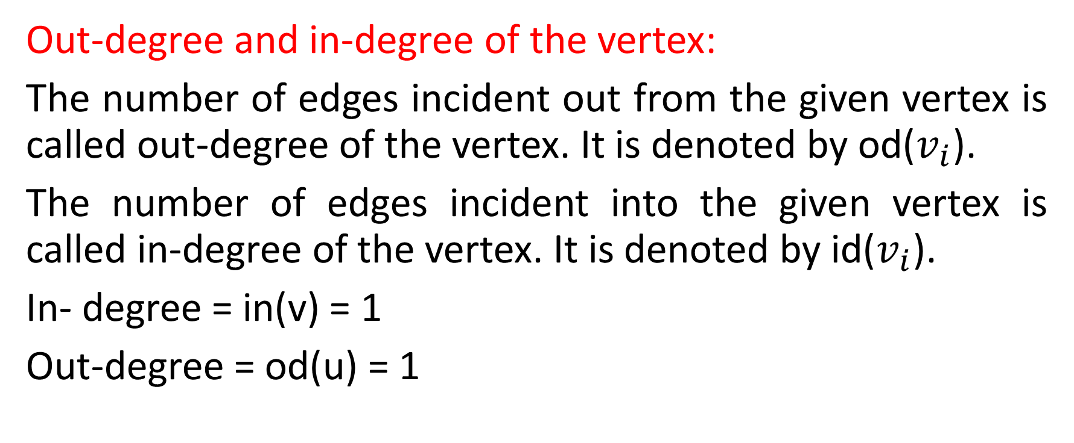
Continued…..
Out-degree and in-degree of the vertex:
The number of edges incident out from the given vertex is called out-degree of the vertex. It is denoted by od($v_{i}$).
The number of edges incident into the given vertex is called in-degree of the vertex. It is denoted by id($v_{i}$).
In- degree = in(v) = 1
Out-degree = od(u) = 1

Slide 12
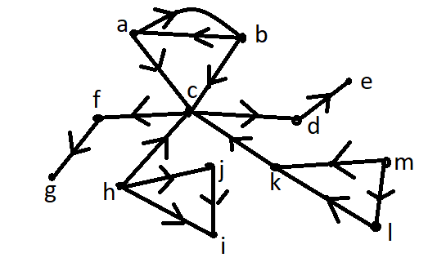
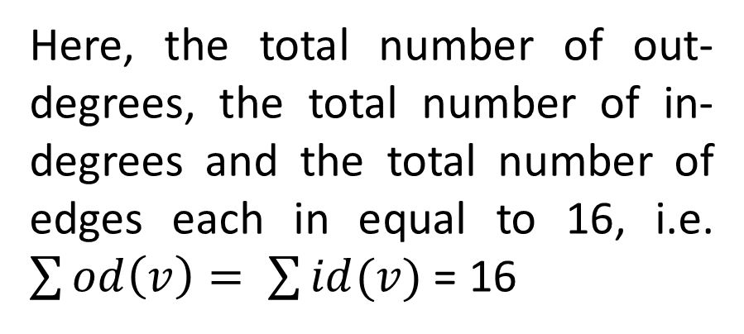
Continued…..
The out-degree and in-degree of vertex given figure is as follows.
vertex | a | b | c | d | e | f | g | h | i | j | k | l | m
Out-degree | 2 | 2 | 2 | 1 | 0 | 1 | 0 | 3 | 0 | 1 | 1 | 1 | 2
In-degree | 1 | 1 | 4 | 1 | 1 | 1 | 1 | 0 | 2 | 1 | 2 | 1 | 0
Here, the total number of out-degrees, the total number of in-degrees and the total number of edges each in equal to 16, i.e. $\sum{od\left(v\right)= \sum{id(v)}}$ = 16

Slide 13
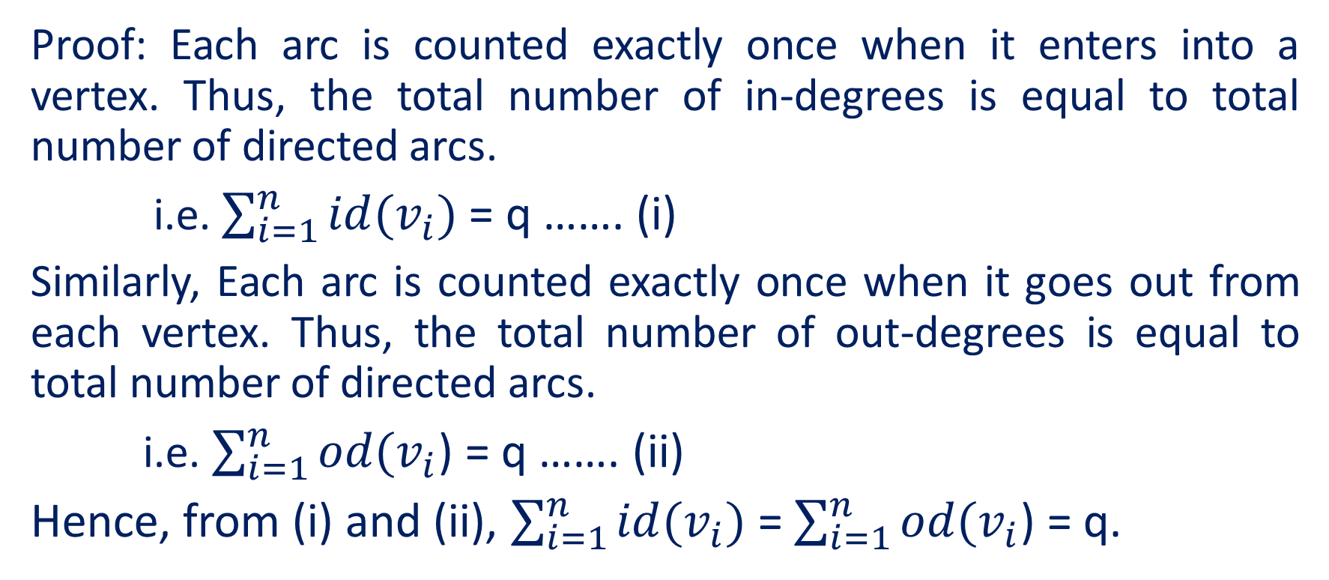
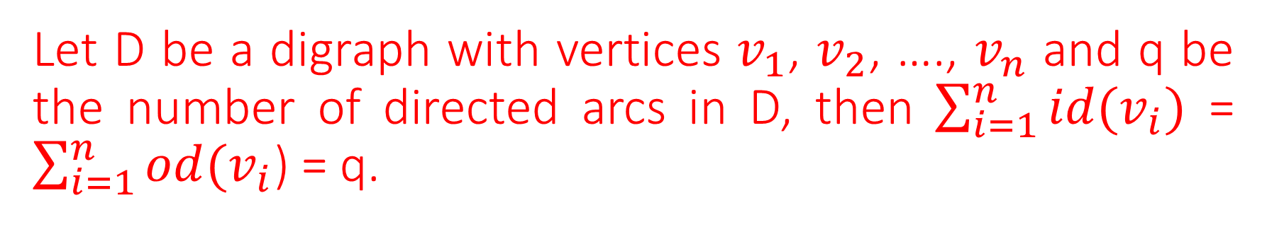
Let D be a digraph with vertices $v_{1}$, $v_{2}$, …., $v_{n}$ and q be the number of directed arcs in D, then $\sum_{i=1}^{n}{id(v_{i})}$ = $\sum_{i=1}^{n}{od(v_{i}}$) = q.
Proof: Each arc is counted exactly once when it enters into a vertex. Thus, the total number of in-degrees is equal to total number of directed arcs.
i.e. $\sum_{i=1}^{n}{id(v_{i})}$ = q ……. (i)
Similarly, Each arc is counted exactly once when it goes out from each vertex. Thus, the total number of out-degrees is equal to total number of directed arcs.
i.e. $\sum_{i=1}^{n}{od(v_{i}}$) = q ……. (ii)
Hence, from (i) and (ii), $\sum_{i=1}^{n}{id(v_{i})}$ = $\sum_{i=1}^{n}{od(v_{i}}$) = q.

Slide 14
Directed trails
Directed trail:
A directed walk W is called a directed trail if all the arcs in W are distinct.
Tour:
A closed trail in a digraph D is called a tour.
Euler tour:
A tour in a digraph D is called Euler tour, if it contains all the edges of D.

Slide 15
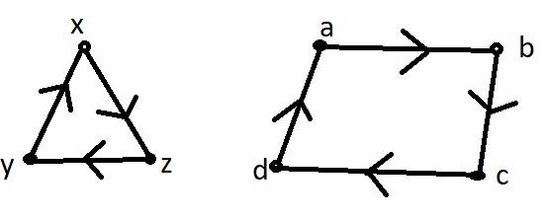
Continued…..
Eulerian:
A tour in a digraph D is called Eulerian, if it contains all the arcs of D exactly once.
Eulerian digraph:
A digraph D is called an Eulerian digraph if it contains a Eulerian tour.

Slide 16
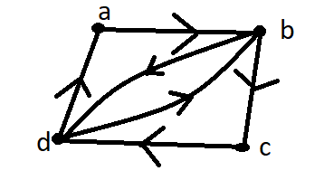

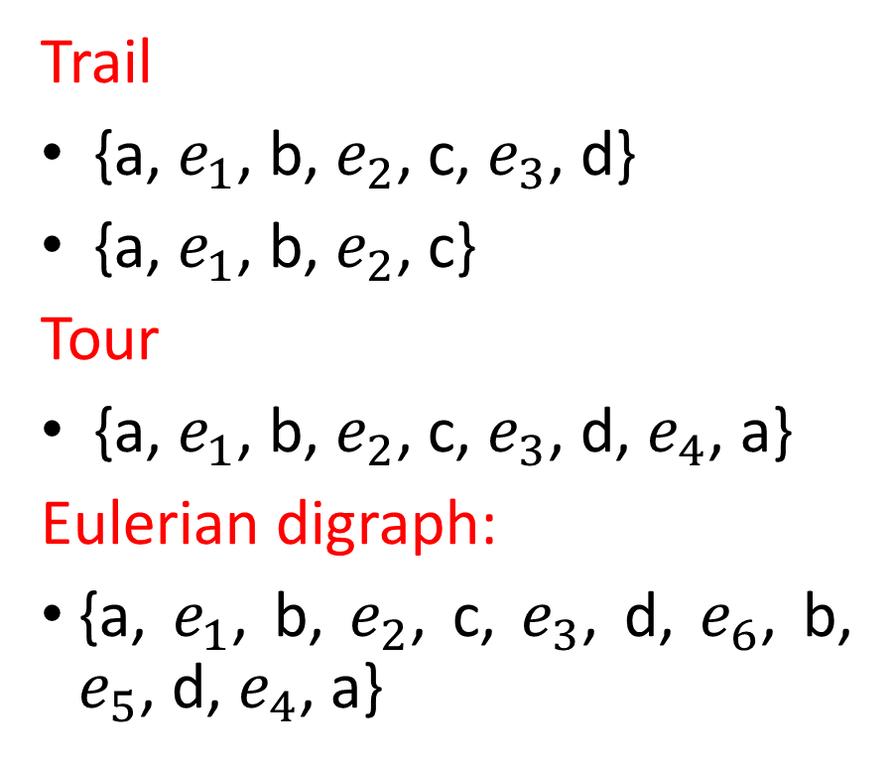





Continued…
Trail
{a, $e_{1}$, b, $e_{2}$, c, $e_{3}$, d}
{a, $e_{1}$, b, $e_{2}$, c}
Tour
{a, $e_{1}$, b, $e_{2}$, c, $e_{3}$, d, $e_{4}$, a}
Eulerian digraph:
{a, $e_{1}$, b, $e_{2}$, c, $e_{3}$, d, $e_{6}$, b, $e_{5}$, d, $e_{4}$, a}
$$e_{1}$$
$$e_{4}$$
$$e_{5}$$
$$e_{2}$$
$$e_{6}$$
$$e_{3}$$

Slide 17
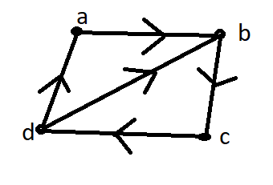
Figure of strongly connected digraph not Eulerian.

Slide 18


